Slide 1
Detection of Covid-19 Informative Tweets using Roberta
Sirigireddy Dhana Laxmi,
Aman Sinha,
Rohit Agarwal
Indian Institute of Technology(Indian School of Mines), Dhanbad
Team name - DSC-IITISM
WNUT - SHARED TASK 2 - Identification of informative COVID-19 English Tweets

Slide 2
Abstract
Social media such as Twitter is a hotspot of user-generated information. In this ongoing Covid-19 pandemic, there has been an abundance of data on social media which can be classified as informative and uninformative content. In this paper, we present our work to detect informative Covid-19 English tweets using RoBERTa model as a part of the W-NUT workshop 2020. We show the efficacy of our model on a public dataset with an F1-score of 0.89 on the validation dataset and 0.87 on the leaderboard.

Slide 3
Shared Task-2
Covid-19 English tweets are categorized into Informative and Uninformative.
A tweet is informative if it indicates any new or suspicious case regarding Covid-19.
The Given Dataset consists of 7000 train data , 1000 valid data and 12000 test data points.

Slide 4
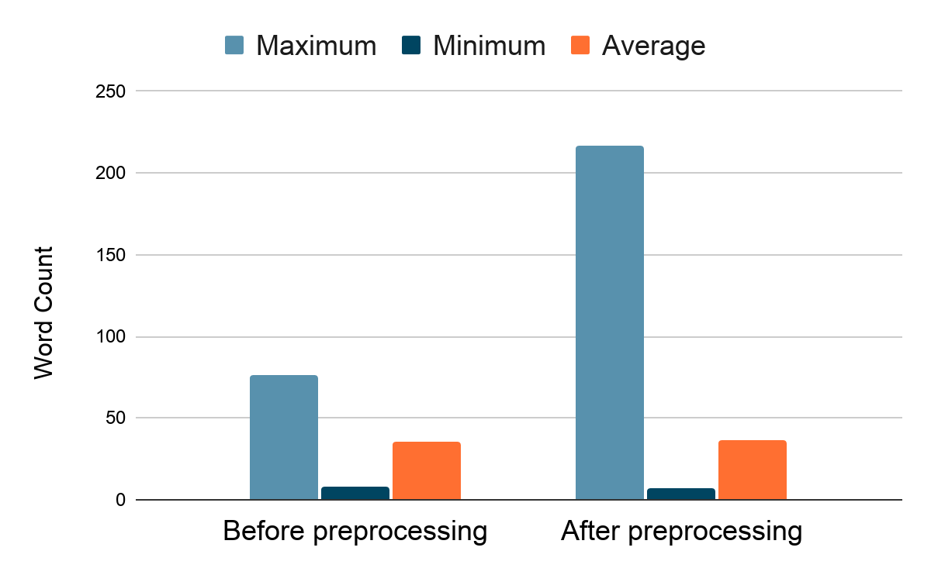
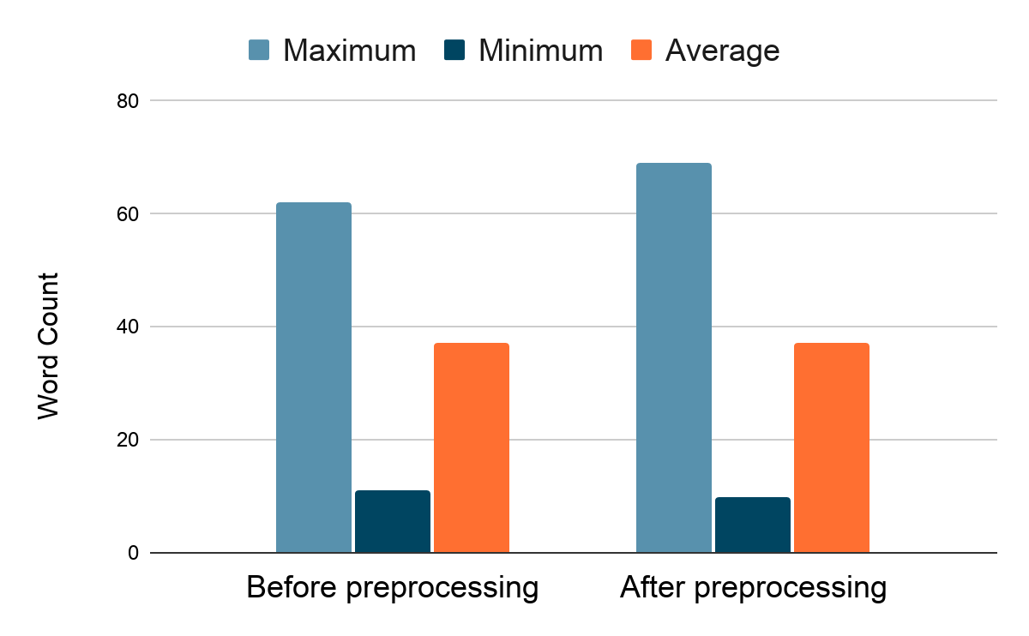
Dataset Analysis
Data Cleaning is the primary step which includes lowercasing, conversion of emojis to text , removal of url and non-ascii characters. The word count of train and valid dataset are represented in histogram as below.

Slide 5
Data Cleaning
Tokenization + Mapping tokens to unique ID’s
Padding
Post Processing
Fix seed for reproducibility
Train Data
Valid Data
Train
Evaluate
Prediction of Labels
Model
Logistic Regression | SVM | NAIVE BAYES | Random Forest Classifier | MLP
BERT (bert-base-uncased) | RoBERTa (roberta-base) | AlBERT (albert-base-v1) | DistilBERT (distilbert-base-uncased)

Slide 6
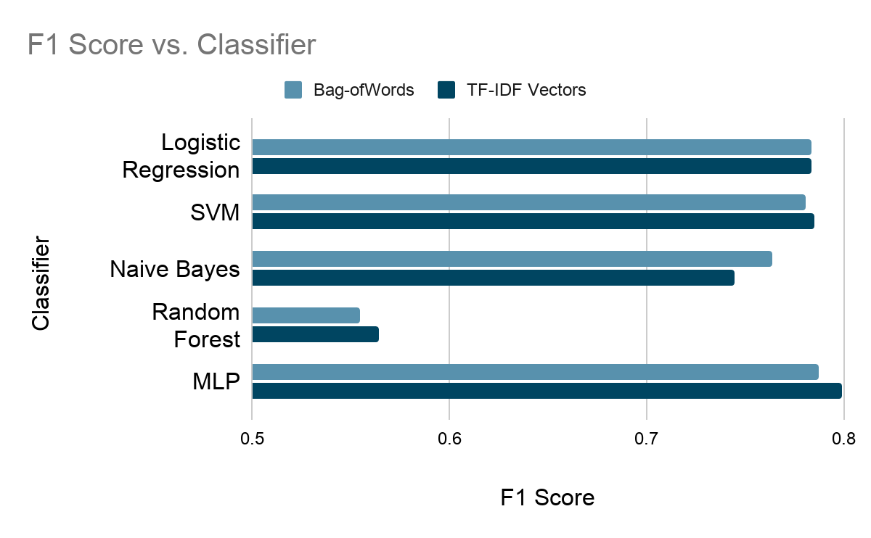
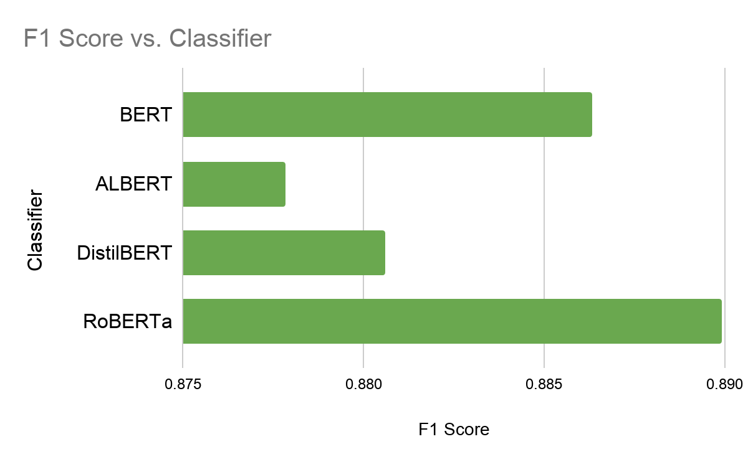
Resukts

Slide 7
Implementation
Clean the dataset
Tokenize the tweets and map them to unique Ids and apply special tokens
Pad the input token and truncate the length of tweet to 100 tokens and apply attention mask.
Split the training set into train and Dev.
Choose batch size and an Optimizer ( AdamW is considered here )
Set torch seed and numpy seed as zero to maintain reproducibility
Train the train dataset using the pre-trained model
Choose step size and number of epochs of training.
Perform a backward pass
evaluate the Dev set
Predict Labels for Valid dataset
Split into batches and evaluate

Slide 8
Analysis and Future Work
We have extensively compared the performance of various methods for this task. We applied conventional approaches and the latest state-of-the-art transformer-based methods.
Since Twitter is primarily a microblogging media, short text classification using topic modeling and topic-enhanced embedding-based approach can also be useful for tweet classification.

Slide 9
References
[1] Ashish Vaswani, Noam Shazeer, Niki Parmar, Jakob Uszkoreit, Llion Jones, Aidan N Gomez, Łukasz Kaiser, and Illia Polosukhin. 2017. Attention is all you need. In Advances in neural information processing systems, pages 5998–6008.
[2] Yinhan Liu, Myle Ott, Naman Goyal, Jingfei Du, Mandar Joshi, Danqi Chen, Omer Levy, Mike Lewis, Luke Zettlemoyer, and Veselin Stoyanov. 2019. Roberta: A robustly optimized bert pretraining approach. arXiv preprint arXiv:1907.11692.

